Slide 1
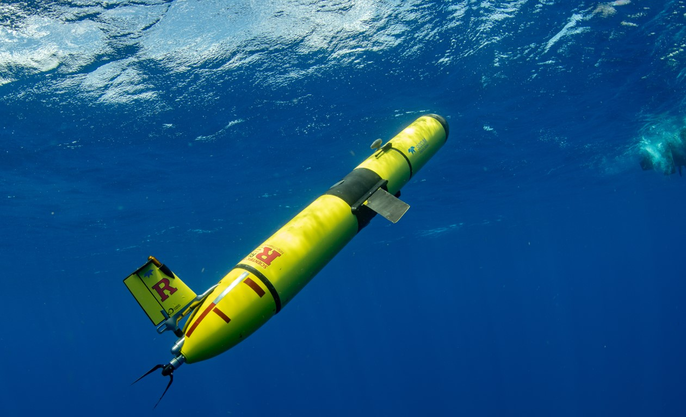

Slide 2
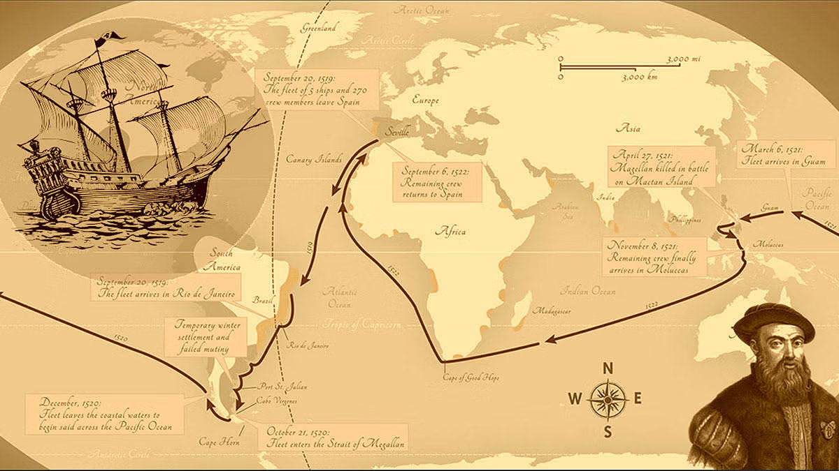
THE SENTINEL GLIDER GOAL
Conduct history’s first underwater circumnavigation of Earth’s ocean
by an Autonomous Underwater Vehicle (AUV)
Use the exploration of the ocean to bring together a global community of students, scientists in a mission of unity, collaboration, and discovery
Ferdinand Magellan’s the first, we know of, to circumnavigate our planet taking 1,082 days.

Slide 3
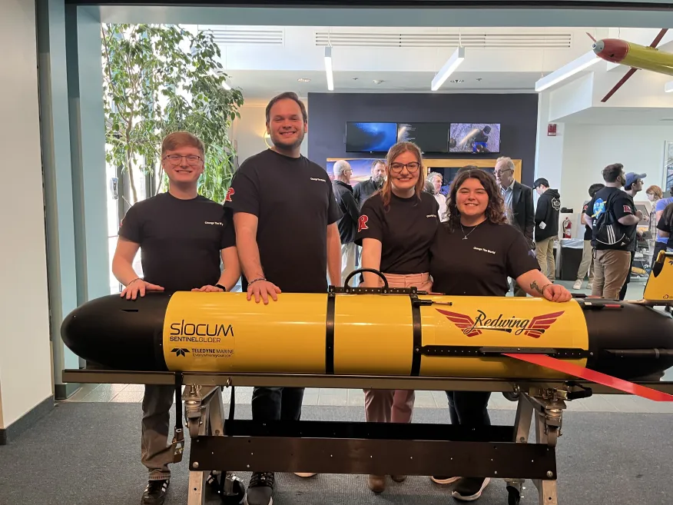
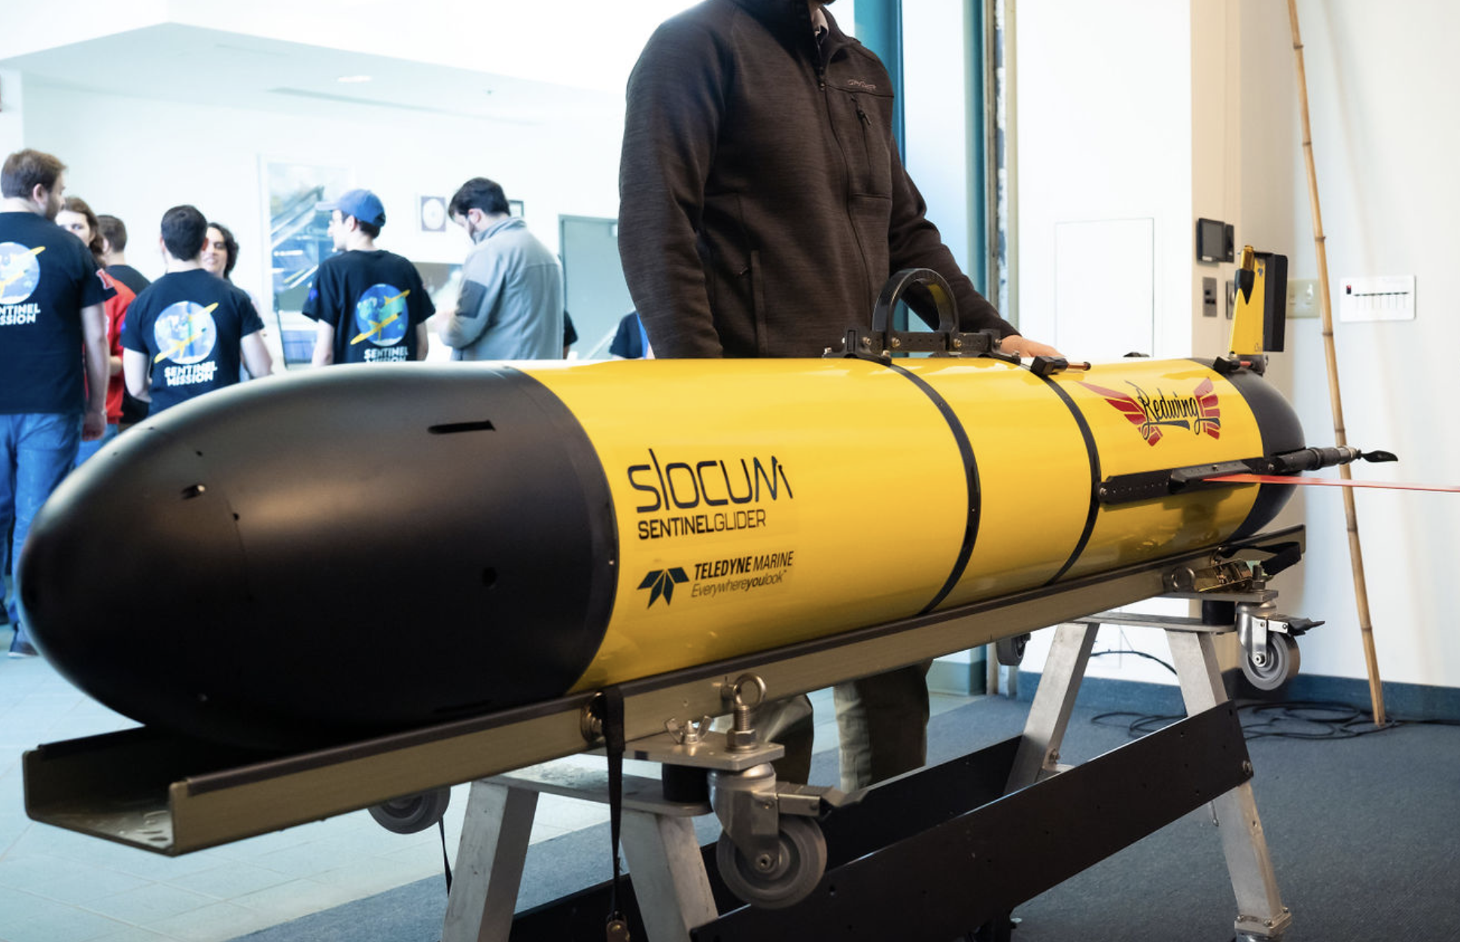
R.E.D.W.I.N.G
OUR ROBOTIC EXPLORER
Notes:
Research & educational doug webb international glider (confirmed) define red wing!

Slide 4
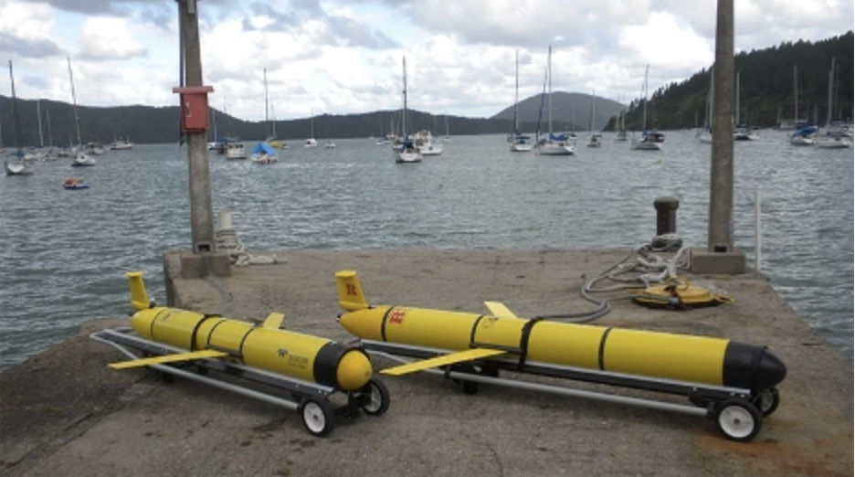
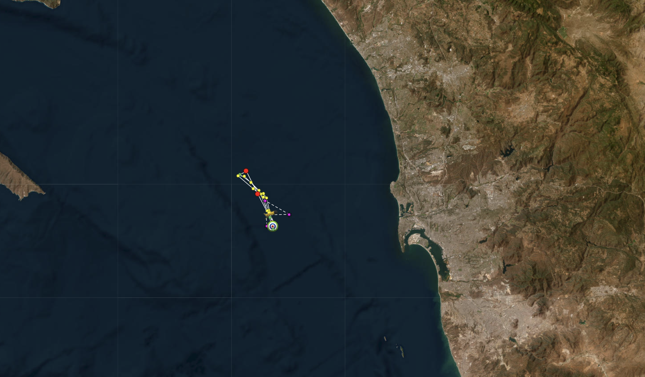
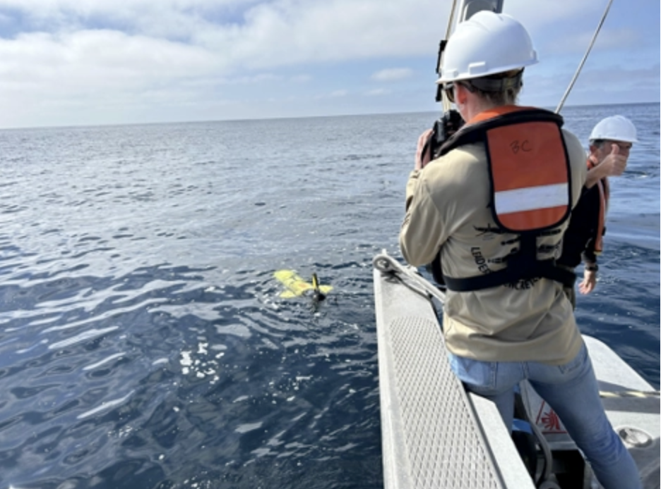
Test Flights Happening Now

Slide 5
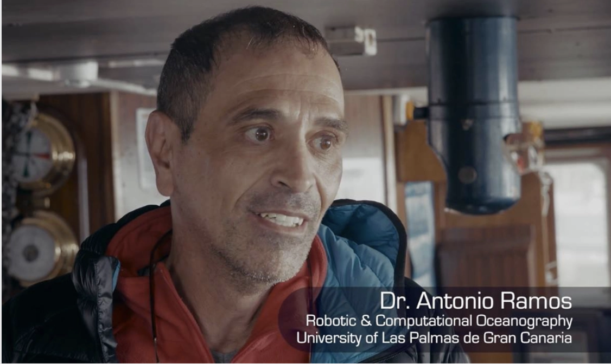
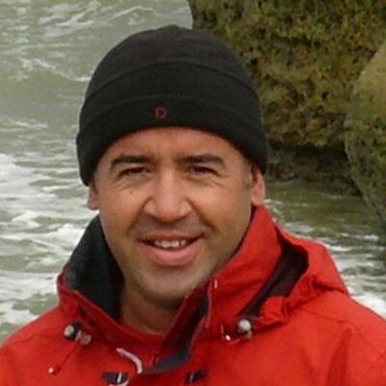
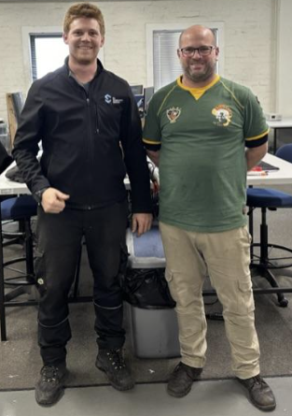
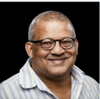
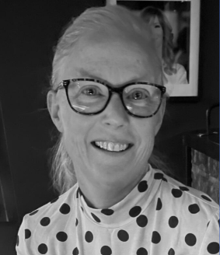
Our Route and Partners
Notes:
moved from after Sentinel glider for flow purposes. Enrique, Doug, & third (talk to professors) Edit pictures to be ovals

Slide 6
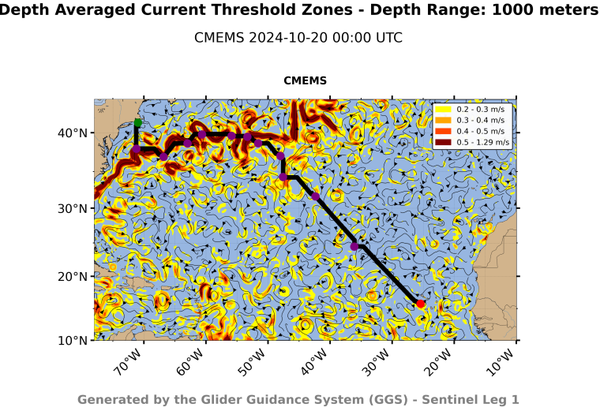
Pathfinders/Mapping
4 Legs that require:
Optimal pathfinding
Hazard avoidance
Understanding of seasonality
Understanding ocean currents
Notes:
(Sophia) TURN THESE PAGES INTO BULLET POINTS; ASK GROUPS NEXT WEEK IF WE FEEL THAT THE BULLET POINTS REPRESENT WHAT THEY WANTED. Add in slide of hazard mapping & different models plus uncertainties
. Add * more information at Pathfinding Table

Slide 7
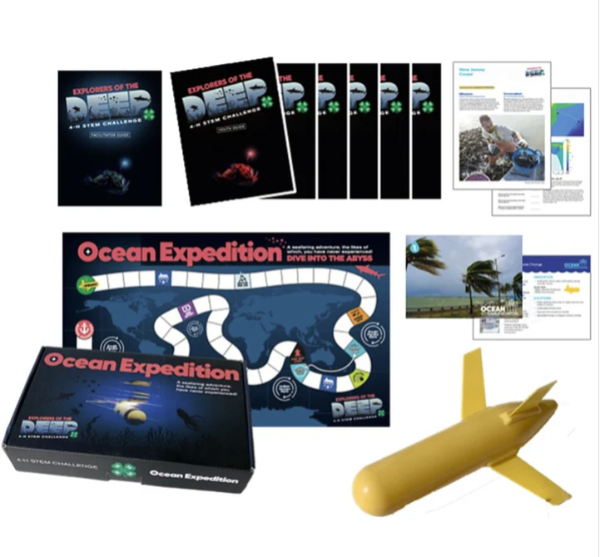
Outreach
Explorers of the Deep:
Board game developed by Rutgers to make learning about ocean exploration & technology even more fun!
Broadening Participation:
U.S. Braille
Metric Values
New questions from areas we will be visiting
Notes:
expanding game accessibility translations drafting international letters monopoly style game pieces ostimizable stickers for trivia questions so can add more spaces to board add high contrast or embossing to make it more visually (Lucus) The international group is working on expanding accessibility to the glider game. Not only does this include numerous languages such as U.S. Brail, Spanish, and Portuguese, but also adjustments to metric values for these communities (E.g., feet to meters). This group is also drafting letters to send to members around the globe to reach these audiences and raise awareness for the red wing mission. Some of the updates being made to the game is an expansion pack with new questions for the cards, an updated version of the map, and new playable pie

Slide 8
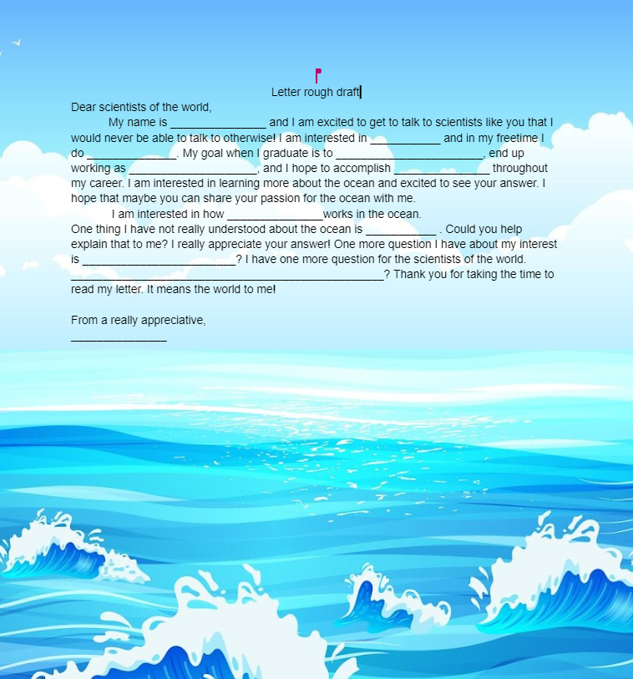
Engaging the Next Generation of Ocean Explorers
Dedicated to education about our mission & ocean science
Student Letters from around the world carried by R.E.D.W.I.N.G.

Slide 9
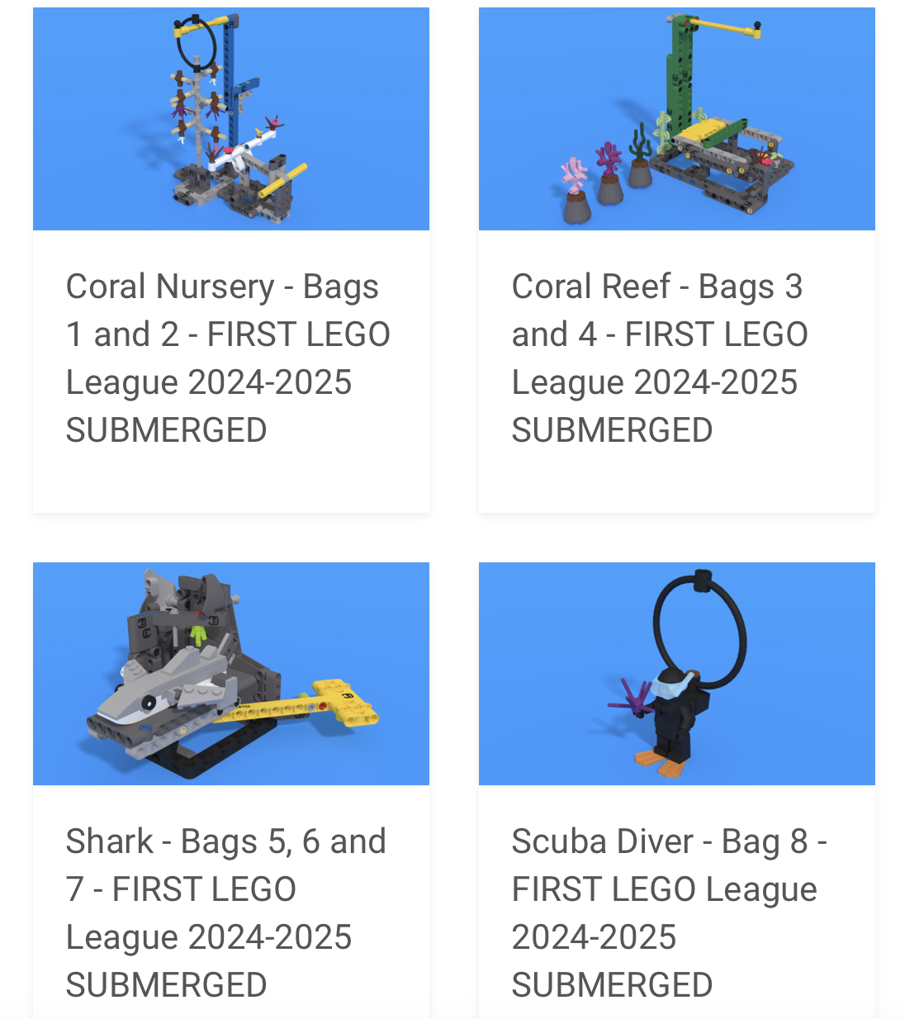
BUILDING INTEREST IN OCEAN EXPLORATION
“Submerged” LEGO Challenge
3rd to 8th Graders
Task: Build a LEGO tool that can be used to observe life in the ocean
Hosted webinar with 50 teams
Notes:
Therefore, this group hosted a webinar to inform over 50 teams about our satellites, HF radar, and gliders and how we use them to collect marine data.

Slide 10
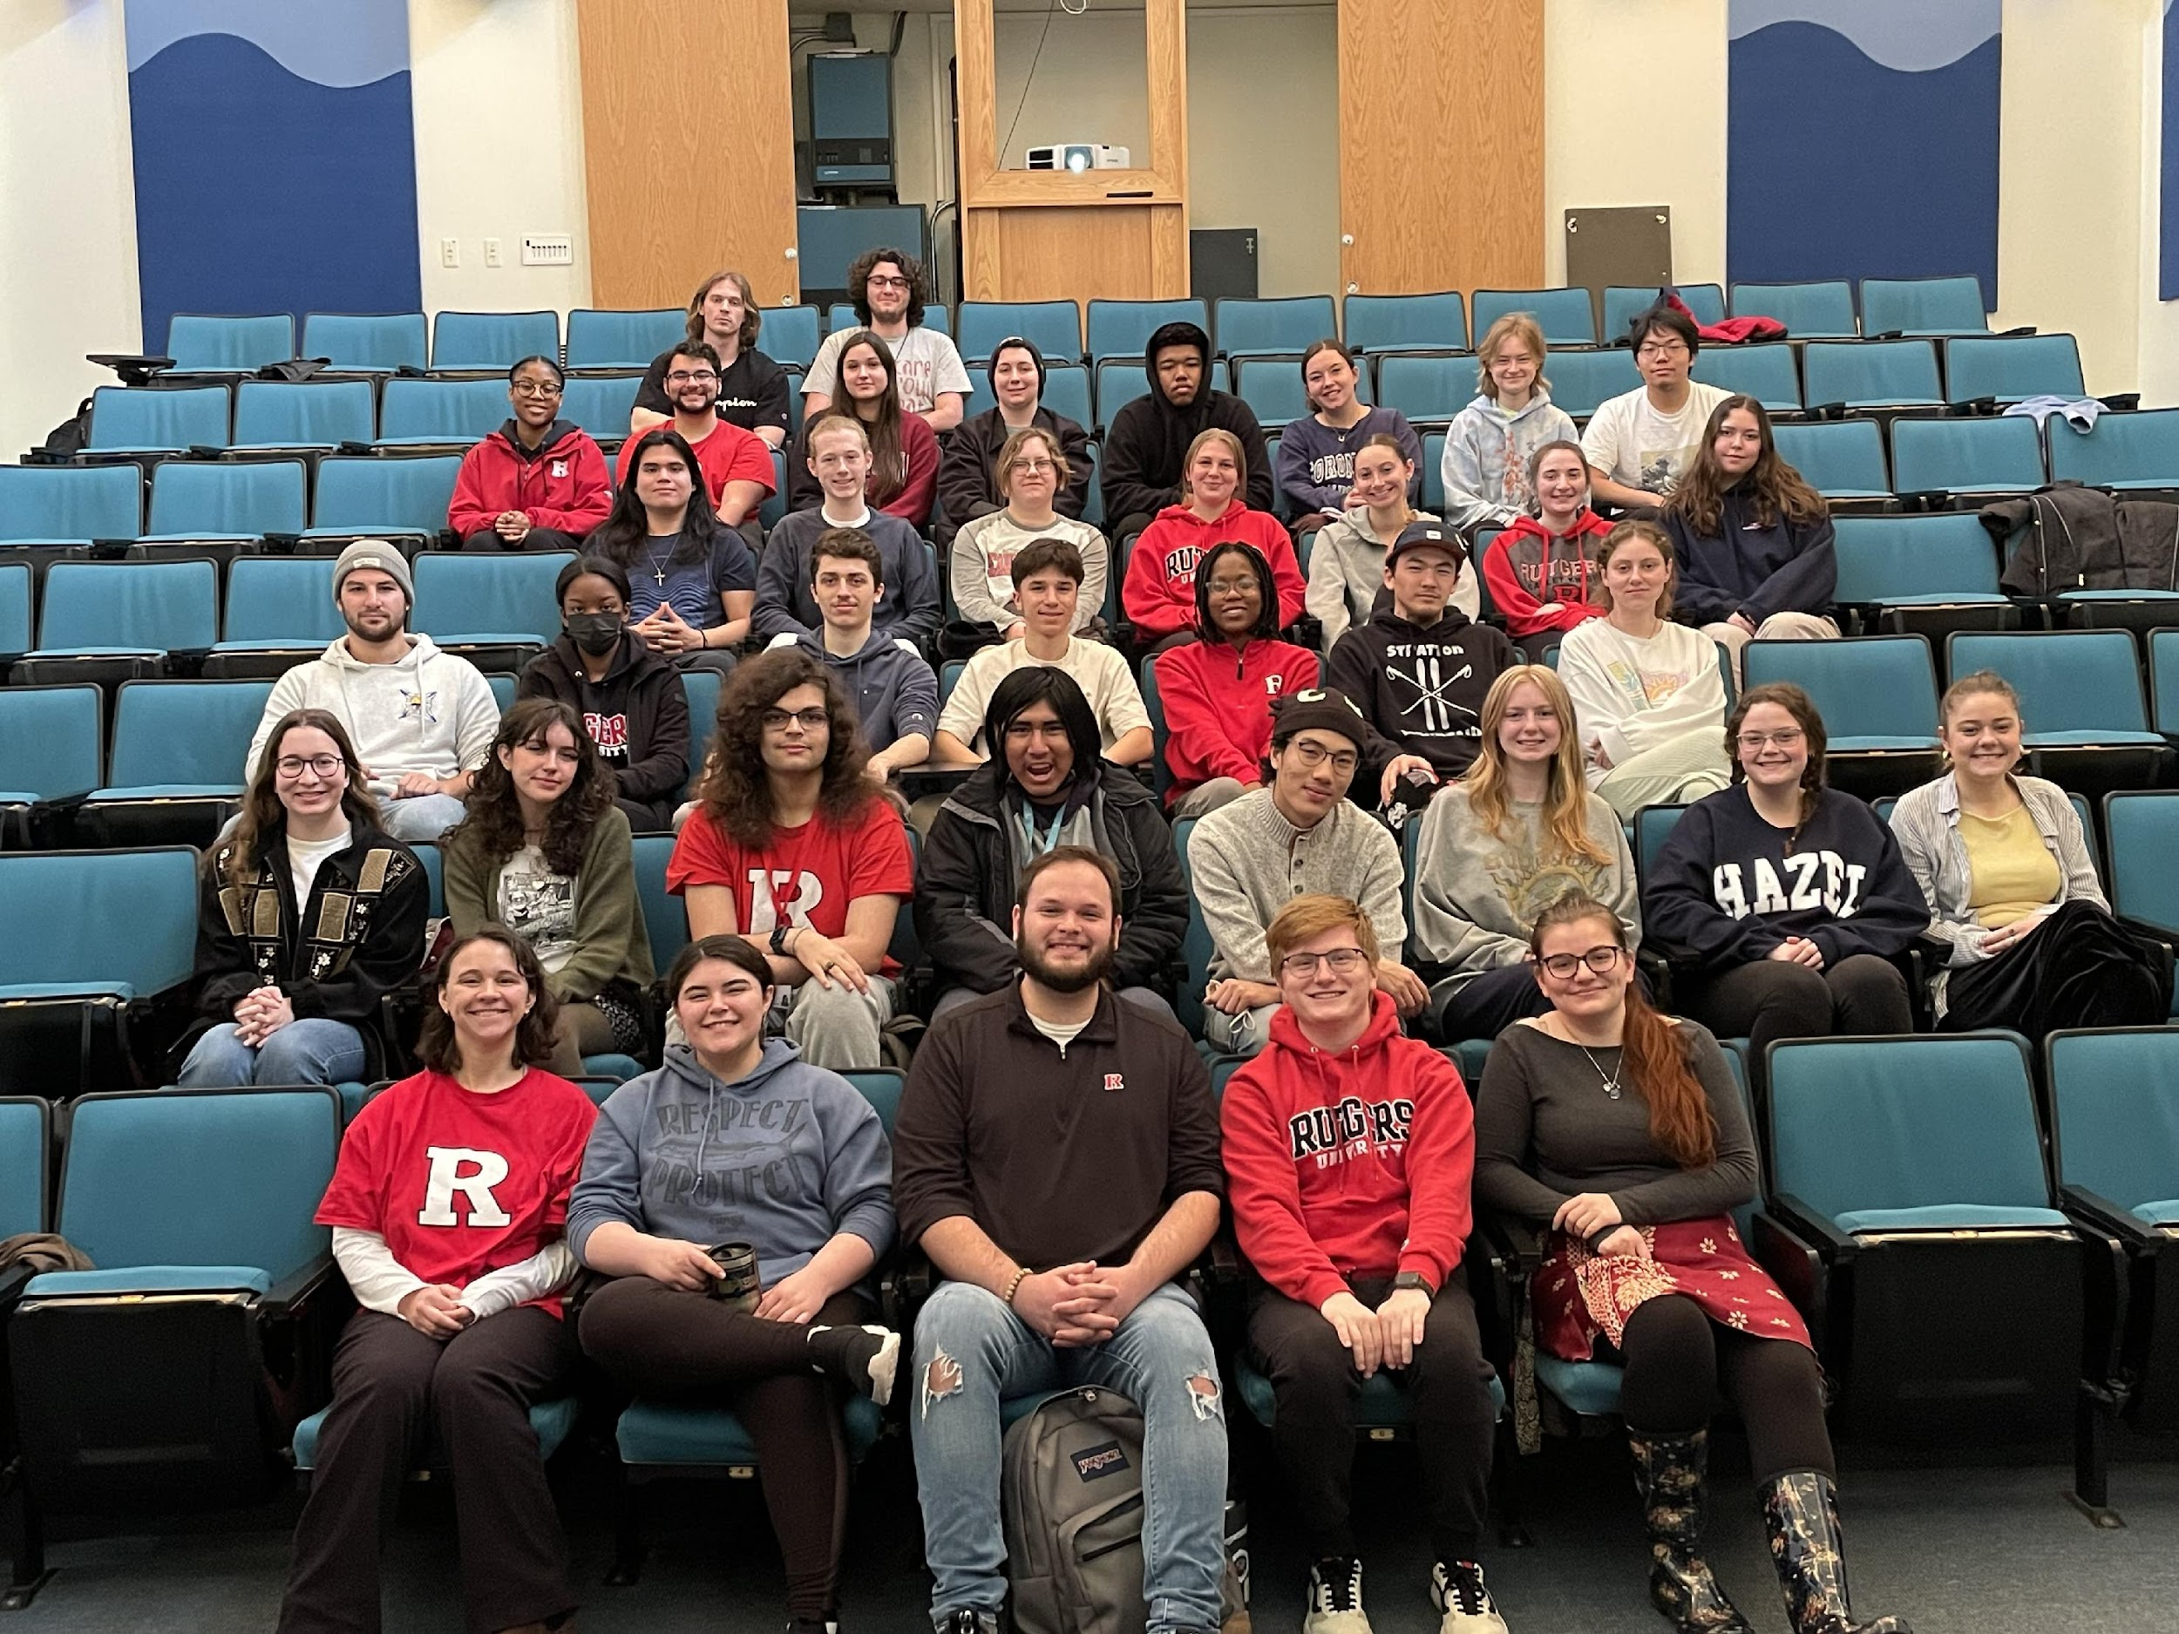
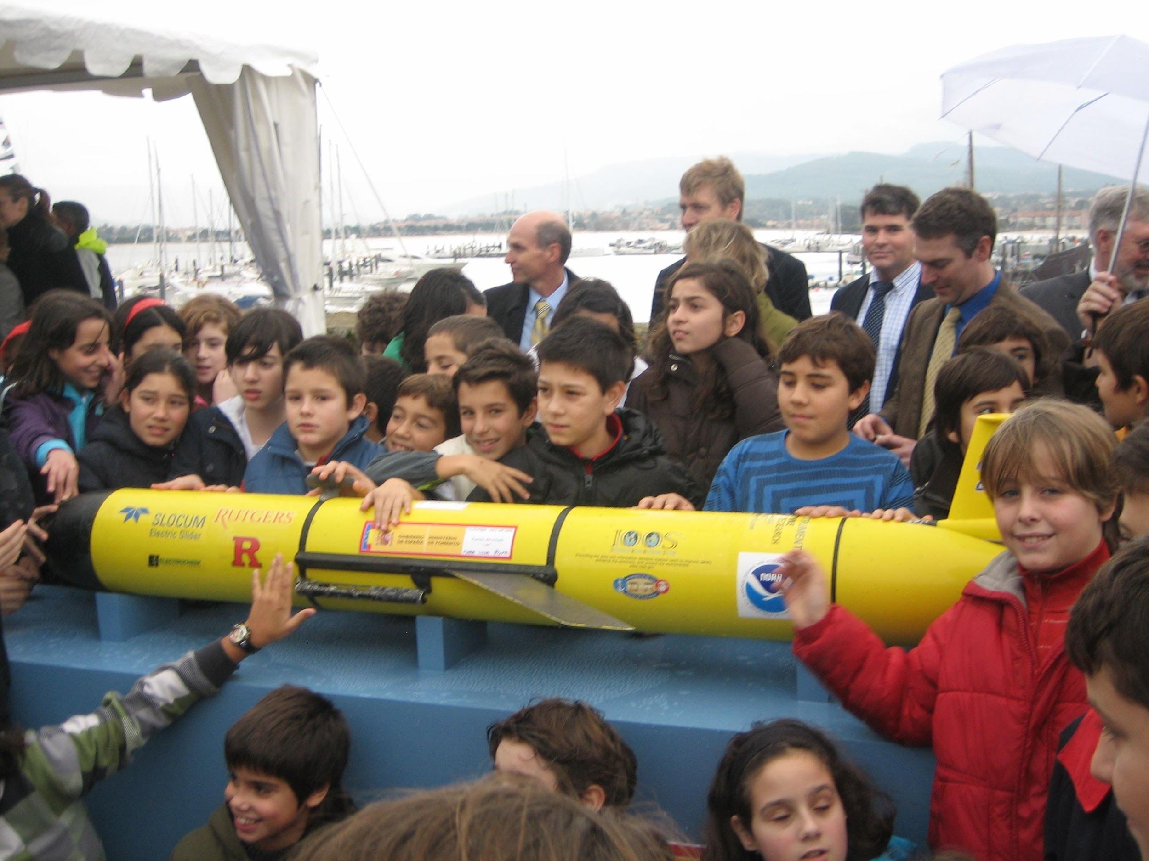
USE THE JOURNEY TO BRING US TOGETHER
Outreach to all with students as the ambassadors!
Pic of Coins or Coin Hand Off
Social Media
Dr. Richard Spinrad
(NOAA Administrator)
https://rucool.marine.rutgers.edu/sentinel-glider-2/
Bring students together through school to
school letters from around the world
Undergraduate Learning, A mission by and
for the next generation

Slide 11
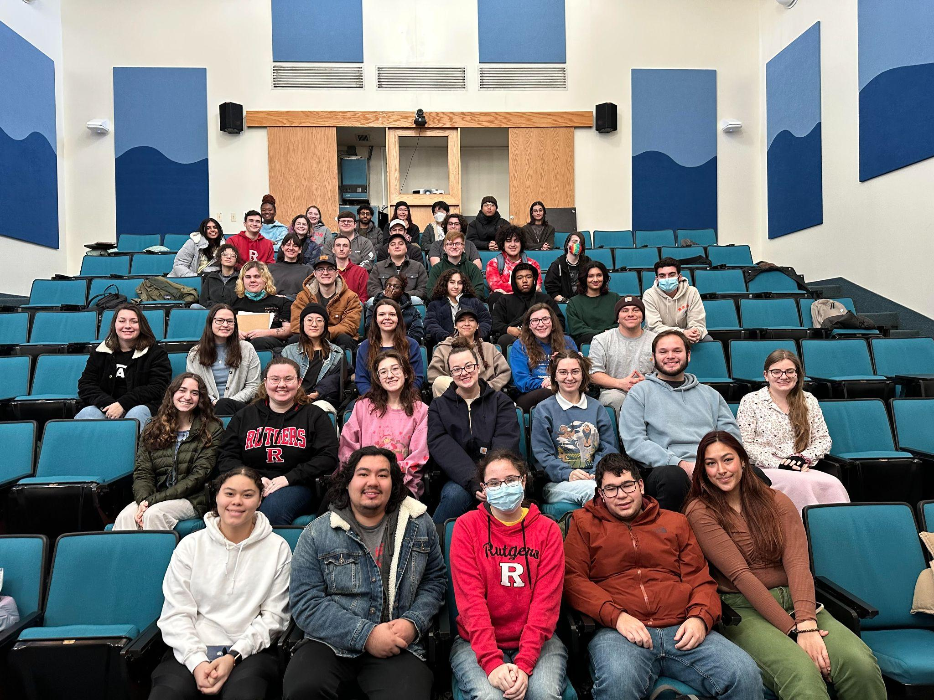
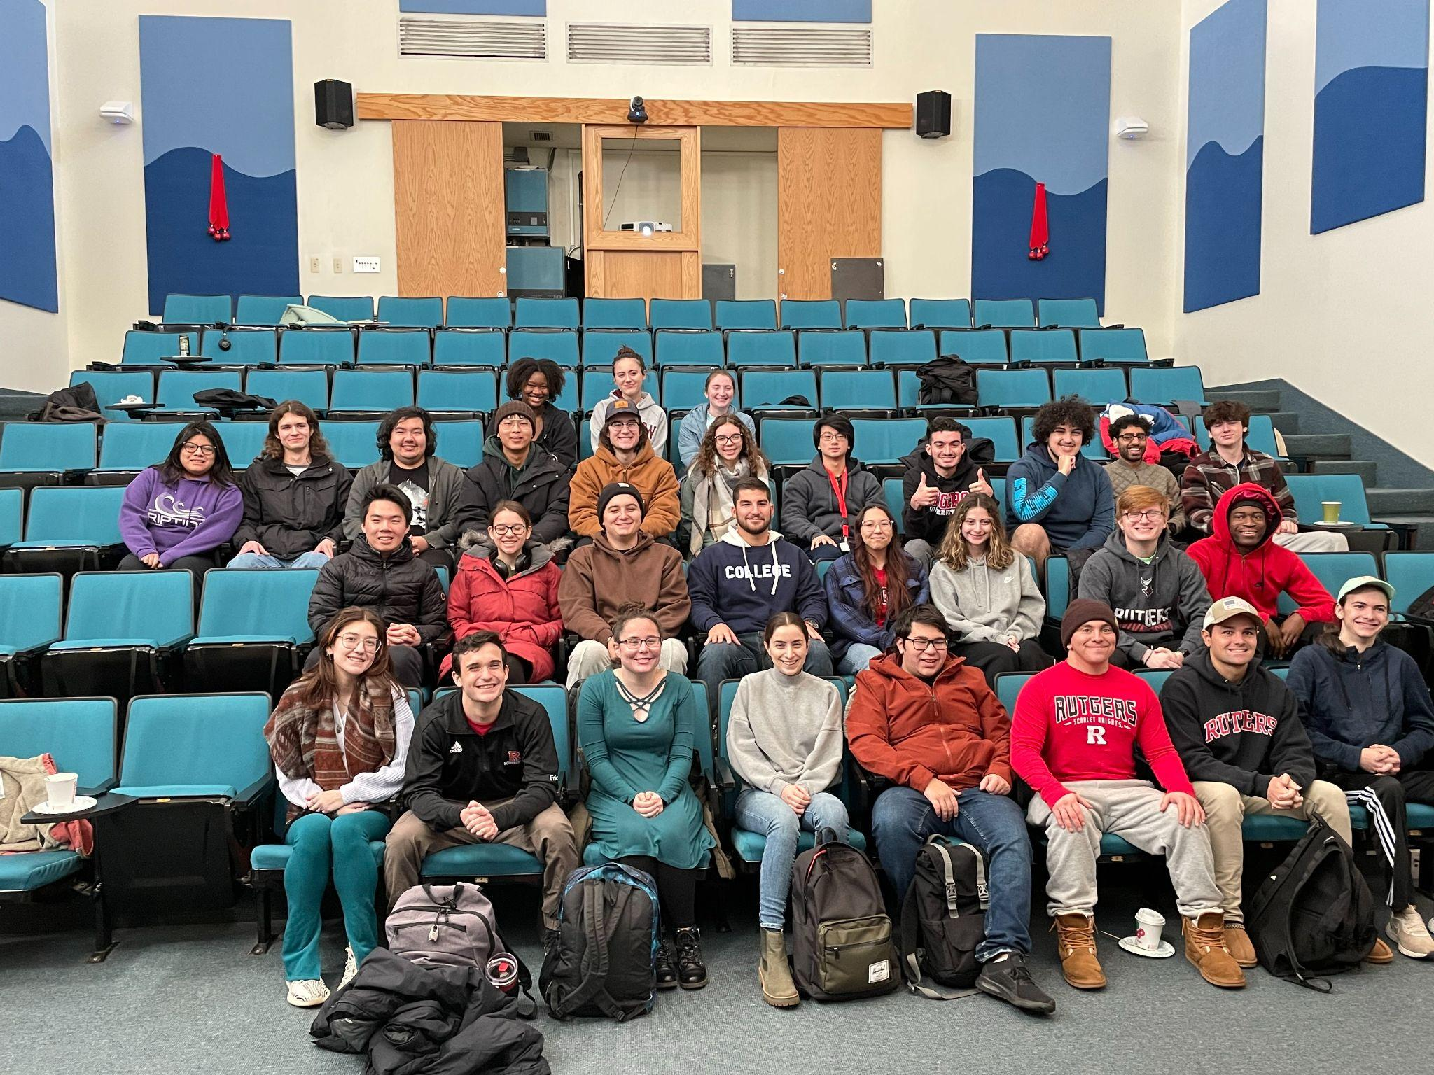
THANK YOU
STAY ENGAGED!
Come visit our
website to
stay updated!
Notes:
highlight student involvement
add school kid picture (classes past undergrads) Janis has pics
Add more info (clueing in( describe what is unique it is whole new prototype
Also 4-H game info statistics abouthow many were sold/ how improving game (spanish + braill US maby spanish)
Add map of whole track Maybe on map + highlight tools developed for flight route
Add partners and logos to route map
“The next first by Rutgers Students” fist to launch glider, first to cross atlantic, first to circumnavigate
Last ocean decade was 50 years ago focused on exploration this one focused on inclusivity

